Slide 1


Chowgacha UHC model & Jhenaidah Sadar Hospital Development by local initiatives
Dr. Md.Emdadul Haque
Senior Consultant (Obst & Gynae)
Sadar Hospital Jhenaidah

Slide 2
Comparative data of health facilities of different country of the world
SL NO | Country | Per capita health Expenditure per year in 2014 by Govt. ($) | Doctors per 10000 Population | Nurse per 10000 Population
01 | USA | 9403 | 24 | 98
02 | UK | 3935 | 28 | 88
03 | Japan | 3703 | 23 | 114
04 | Malaysia | 456 | 12 | 33
05 | Sri Lanka | 127 | 7 | 19
06 | India | 75 | 7 | 17
07 | Nepal | 40 | 8 | 6
08 | Pakistan | 36 | 8 | 6
09 | Bangladesh | 31 | 3.6 | 2.2
From internet 2015

Slide 3




Community Mobilization Meeting at Lohagara in 1995

Slide 4

50 BEDED UPAZILA HEALTH COMPLEX
Chowgacha, Jessore.

Slide 5
A Sub-district level Women-Friendly Hospital with a Vision …
Maximum utilization of Govt.
resources with
honesty and sincerity
Integrated approach of
Administration, Community
Leaders & Health
Management
Providing Effective and
prompt services
through improved
management system

Slide 6



Blood donation program stared in 16 December, 1996 in Chowgacha UHC
A seminar held on basic information system at Chowgacha Degree College in June, 1997. DC Jessore was the chief guest .

Slide 7





Slide 8





Slide 9

Upazila Health Complex
CHOWGACHA , JESSORE.
EOC Activities : 1997- 2011 (Hospital Delivery )

Slide 10

Upazila Health Complex
CHOWGACHA , JESSORE.
EOC Activities : 2000 - 2011 (Caesarian Section)

Slide 11
Upazila Health Complex
CHOWGACHA , JESSORE.
EOC ACTVITIES : ( Vision By The Year 2010)
SL No | Indicator | Achived |  |  |  |  |  |  |  | Target
 |  | 1997 | 2000 | 2003 | 2005 | 2006 | 2007 | 2008 | 2009 | 2010
01 | ANC 1st Visit % | 24.6 | 59 | 88 | 94.7 | 110.8 | 133.7 | 143.0 | 147 | 100
02 | ANC 2nd Visit % | 11.6 | 33.4 | 59.7 | 68 | 78 | 91.2 | 108 | 119 | 100
03 | ANC 3rd Visit % | 9.2 | 22 | 30 | 39 | 40 | 49.6 | 59.6 | 109 | 100
04 | PNC % | - | 5.5 | 9.9 | 13.5 | 20.11 | 11.2 | 39.3 | 64 | 80
60 | Hospital Delivery Rate% | 3.4 | 6.4 | 15 | 26.5 | 32.3 | 38.1 | 52.4 | 72 | 90
06 | Caesarian Section Rate% | 0 | 0.07 | 0.8 | 6.3 | 7.4 | 9.6 | 11.0 | 17.3 | 15
07 | Maternal Mortality Ratio / 100000 Live birth | 210 | 168 | 114 | 160 | 150 | 160 | 120 | 42 | 42
08 | Neonatal Death Rate / 1000 live birth | 42.4 | - | 28 | 21.5 | 20.5 | 21.5 | 16.5 | 19.3 | 15

Slide 12
Upazila Health Complex
CHOWGACHA , JESSORE.
Comparative Data of Delivery of best performing EOC center of Khulna Division in 2011
SL No | Name of institute | NVD | Vacuum Del. | V. Breech | C. Section | Total
01. | Chowgacha UHC | 3346 | 34 | 26 | 1007 | 4413
02. | Ad-din Hospital Jessore. | 1124 | 0 | 0 | 1864 | 3492
03. | Khulna Medical College Hospital | 1581 | 58 | 18 | 1356 | 3013
04. | 250 bed Hospital, Jessore | 1327 | 2 | 25 | 1498 | 2852

Slide 13
Upazilla Health Complex
CHOWGACHA , JESSORE.
COMMUNITY SUPPORTED MANPOWER
TOTAL :46
  Volunteers :26
  Cleaners & guards :16
  Others :04
  The remunerations come from
  Outsourcing :25
  Service provider :21
  The amount of remuneration ranging from 200/= To 8000/=tk. Per month depending upon the style of work, which costs a total of nearly 90,ooo/=Tk per month.

Slide 14
MDG 4 and 5 Achieved at Chowgacha in 2009
Per 1000 live Birth Chowgacha MDG Target National
MMR: .42 1.47 3.2
(MDG 5 Achieved)
IMR: 20.6 31 52
(MDG 4 Achieved)
<5 MR: 22.7 50 65
(MDG 4 Achieved)

Slide 15
Achievement of Chowgacha Health Complex
From 1996 to 2012, took initiatives to develop Upazilla level standard services in Chowgacha health complex.
In 2008, Chowgacha Health Complex declared as the model upazilla health complex.
  Mobilized 46 additional workers from community (26 volunteer, 12 cleaners and others 8).
  EOC Beds increased from 11 to 41(Extra-30)
  Chowgacha UHC became the best EOC center with 98.4% delivery rate in 2011.
  Chowgacha UHC achieved MDG target in 2009.
  Chowgacha Health complex is awarded for best performance in EOC form 2005 to 2014.

Slide 16






Slide 17

100 kh¨v wewkó m`i nvmcvZvj, wSbvB`n

Slide 18
Health ,Nutrition and population targets for the 7th FYP
Sr # | Indicator (Impact/Outcome) | Base year’s information(source with year) | 7th FYP target FY 2020
1 | Life Expectancy at Birth | 70.4 (SVRS 2013) | 72
2 | Under-five Mortality Rate (per 1,000 live births) | 46 (BDHS 2014) | 37
3 | Infant Mortality Rate (per ,1000 live births) | 38 (BDHS 2014) | 20
4 | Maternal Mortality Ratio(per 100,000 live births) | 170 (MMEIG 2013) | 105
5 | Proportion of Under Weight among Under-five children (%) | 32.6 (BDHS 2014) | 20
6 | Proportion of stunting among Under-five children (%) | 36.1 (BDHS 2014) | 25

Slide 19
Health ,Nutrition and population targets for the 7th FYP
Sr # | Indicator (Impact/Outcome) | Base year’s information(source with year) | 7th FYP target FY 2020
8 | Total Fertility Rate (Children per Woman) | 2.3 (BDHS 2014) | 2.0
9 | Contraceptive Prevalence Rate (%) | 62.4 (BDHS 2014) | 75
10 | Proportion of children fully vaccinated by 12 months (%) | 78 (BDHS 2014) | 95
11 | Proportion of births attended medically trained provider (%) | 42.1 (BDHS 2014) | 65
12 | Proportion of births in health facilities by wealth quintiles (Ratio of lowest and highest quantities) | 15:69.5 (BDHS 2014) | 1:3.5
12 | TB case detection rate (%) | 53 (GTR 2014 ) | 75
Source: Ministry of Health and Family Welfare

Slide 20
Sadar Hospital, Jhenaidah
Important post of Human Resources
Serial No. | Person | Post | Vacant
01 | Doctor | 40 | 11
02 | Nurse | 63 | 03
03 | MLSS, Ward boy, Ayah | 16 | 0
04 | Cleaner | 07 | 00
05 | Guard | 03 | 00
06 | Gardener | 01 | 00
07 | Electrician | 01 | 00
08 | Trolley man | 00 | 00
09 | Others | --- | ---
 | Total | 151 | 31

Slide 21

Sadar Hospital, Jhenaidah
Bed Occupancy Rate from 1998 to 2017

Slide 22
Emergency & Out Door, Indoor Service 1998 to 2017
Sadar Hospital, Jhenaidah

Slide 23
Operation Service (Major) 2011 to 2017
Sadar Hospital, Jhenaidah

Slide 24
Sadar Hospital, Jhenaidah
Admitted Under 5 children in indoor from 2014 to 2017

Slide 25
3 best performing EmOC Hospital in Khulna division - 2017
Sadar Hospital, Jhenaidah

Slide 26
Comparative data of revenue income (in Taka) from 2015 to 2017
Sadar Hospital, Jhenaidah

Slide 27
Community Support System in Sadar Hospital
53 manpower (Cleaner 20, Ayah & ward boy 21, Guard 6, Volunteer 3, Trolley man 3 ) is supported by the community.
MP of Jhenaidah-2 donated 14 manpower support.
Chairman of Zahedee foundation supports 10 manpower and an intercom with a cost of nearly two lac taka.
Mayor of Jhenaidah Paurasava plays an important role in security , cleanliness, repaired the boundary wall and supports 5 man power and renovation of pediatric word and donation of a biochemistry analyzer at a cost of 1,15,000 Taka.
Retired secretary donated a generator for 24 hours OT service with a cost of nearly 33 thousand taka.
Former-chairman of Jhenidah Pourosova supports 2 manpower
Doctors of the hospital and Jhenaidah town supports 17 man power.

Slide 28




Visit to Shatkhira District Hospital and Introduction of TQM activities

Slide 29




Changes in EOC Ward
Before
After
Before
After

Slide 30








Changes in Surgery & Pediatric Word

Slide 31





Changes in Gardens of The Hospital
Before
After
Before
After

Slide 32




Waste Management & Campus Protection
Before
After
Before
After

Slide 33




Changes in Office and Hospital Internal Environment
Before
After
Before
After

Slide 34




Use of direction sign, labeling of rooms, clean latrine and waste segregation
Use of direction sign
Labeling of rooms
waist segregation
Clean latrine

Slide 35




Use of color code, alignment of picture & continuous big cleaning day
Color code
Color code
Alignment of pictures

Slide 36




Innovative activities of Jhenaidah Sadar Hospital - 1
Reception room
Creation of nursing aid
Health education session
Community engagement

Slide 37




Innovative activities of Jhenaidah Sadar Hospital - 2

Slide 38




Innovative activities of Jhenaidah Sadar Hospital - 3

Slide 39




Innovative activities of Jhenaidah Sadar Hospital - 4

Slide 40




Innovative activities of Jhenaidah Sadar Hospital - 5

Slide 41




Involvement of MP, District Administrator & Mayor in Sadar Hospital

Slide 42




Involvement of district high officials in hospital activities

Slide 43




Internal Monitoring System
Meting of health improvement committee
Meting of community support group committee
QIC meeting
Monthly meeting schedule

Slide 44




Improved pediatric word by local initiative

Slide 45




Hospital Environment

Slide 46
Jhenaidah Sadar Hospital, Jhenaidah
Achievement of the Hospital
1. Active Community Participation in health service is an example in Bangldesh.
2. Improved performance of all services specially Pediatric, obstetric, operation and outdoor service.
3. Improved Cleanliness and Beautification of Campus.
4. Functioning of X-Ray service and starting of Biochemistry investigation by local initiatives.
5. Improved Security.
6. Improved Financial Management
7. Piloting of “Model District Hospital” is running in Jhenaidah Sadar Hospital.
8. The hospital is awarded 5 times from 2013 to 2017. Stood first award by 5S-KAIZEN-TQM among the 100 bedded district hospitals by defeating Norsindi Sadar Hospital.

Slide 47

Thank You
Notes:
47

Slide 48
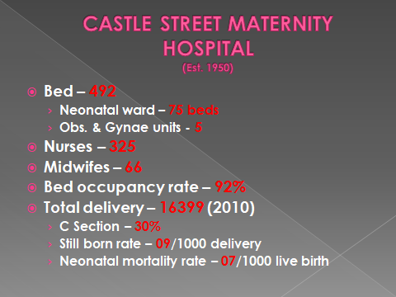
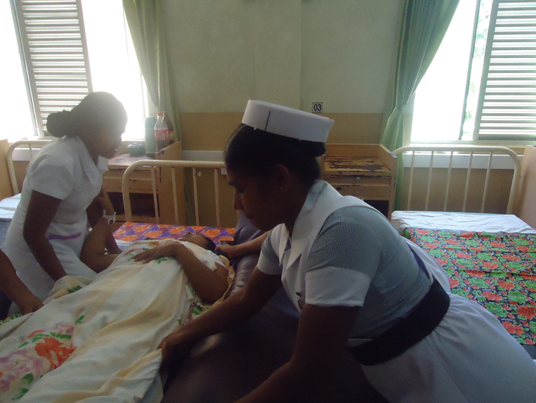
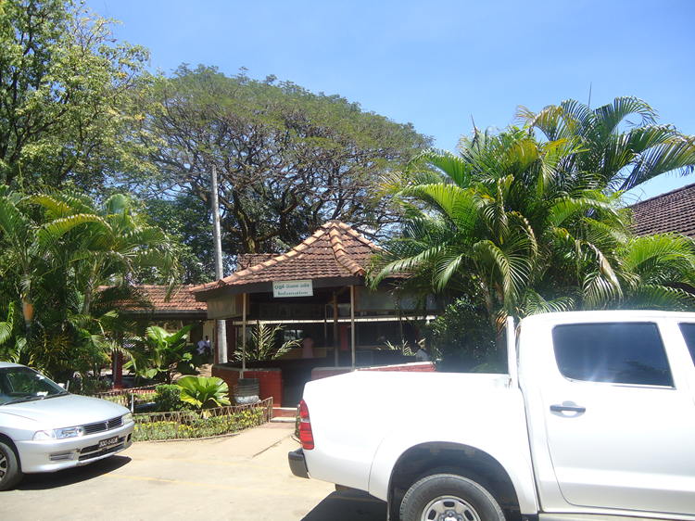
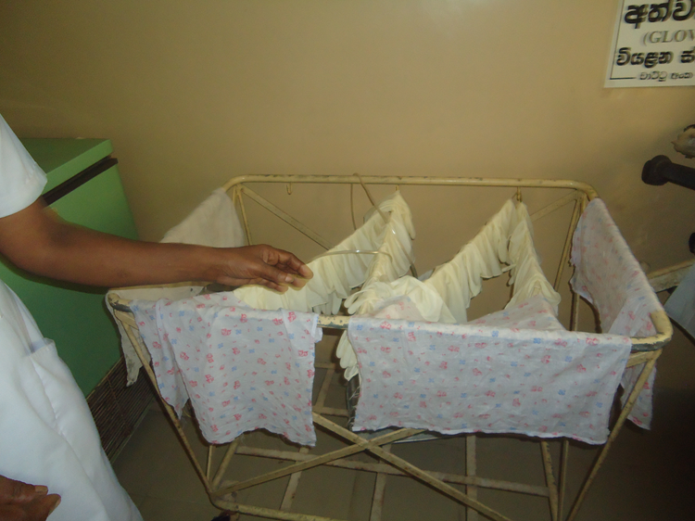
Experience in Srilanka

Slide 49
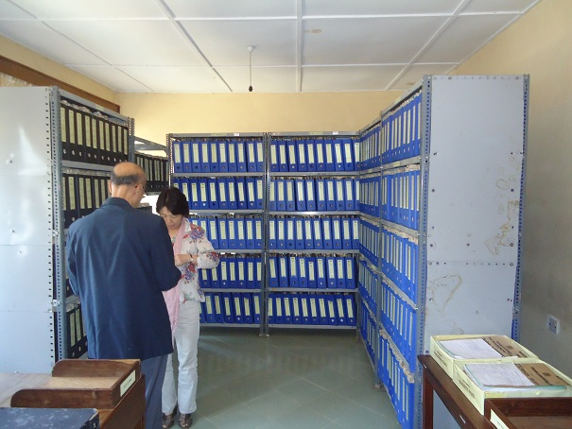
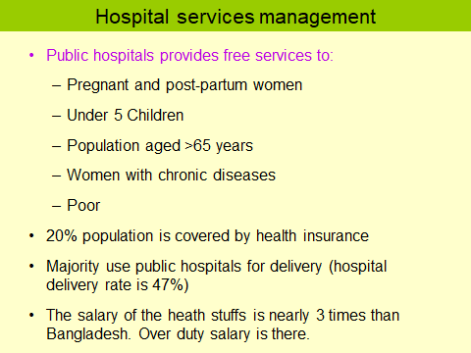
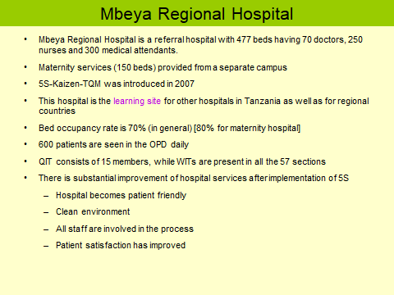
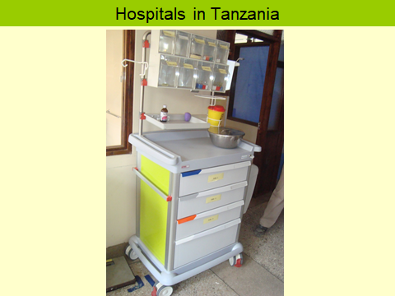
Experience in Tanzania

Slide 50
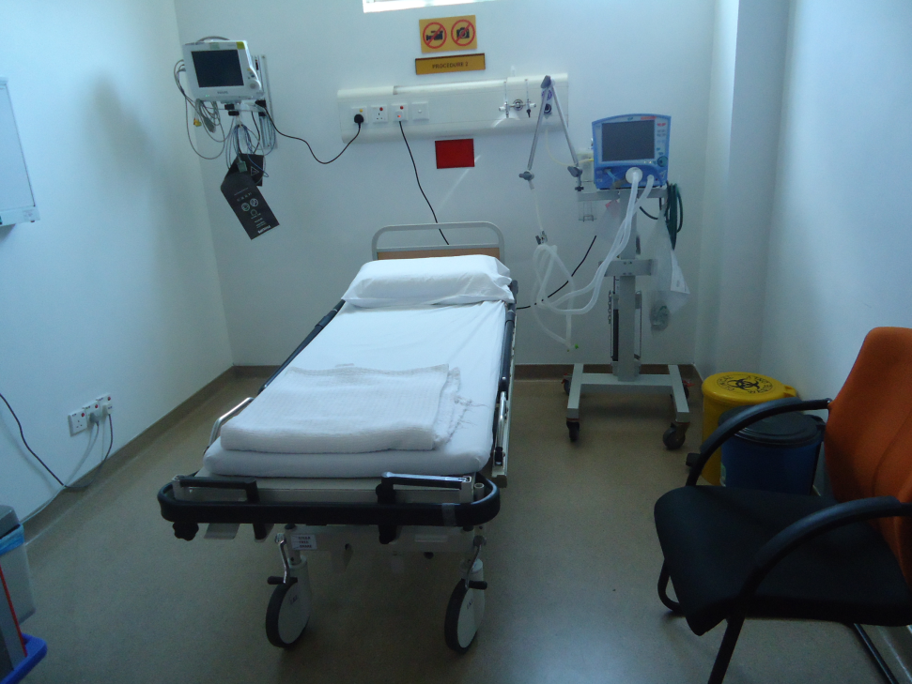
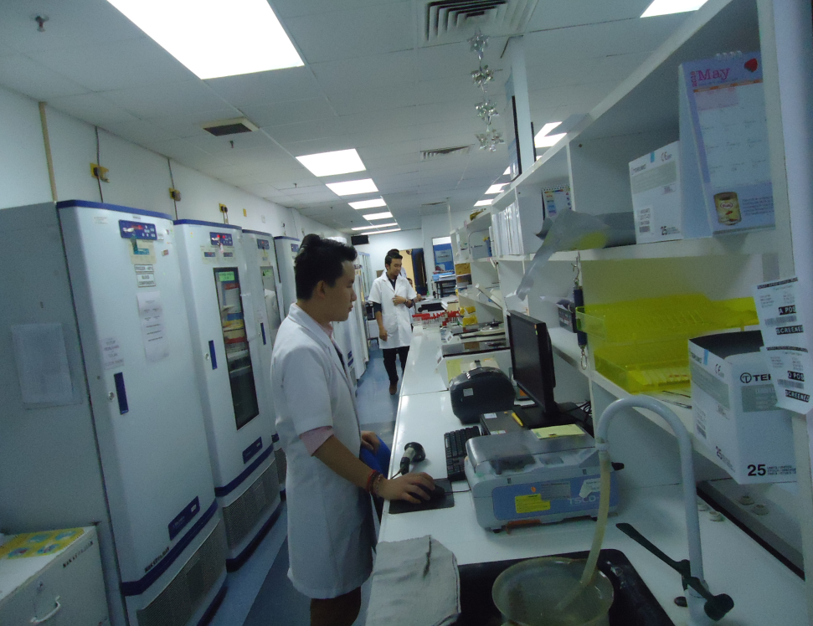
Experience in Malaysia

Slide 51
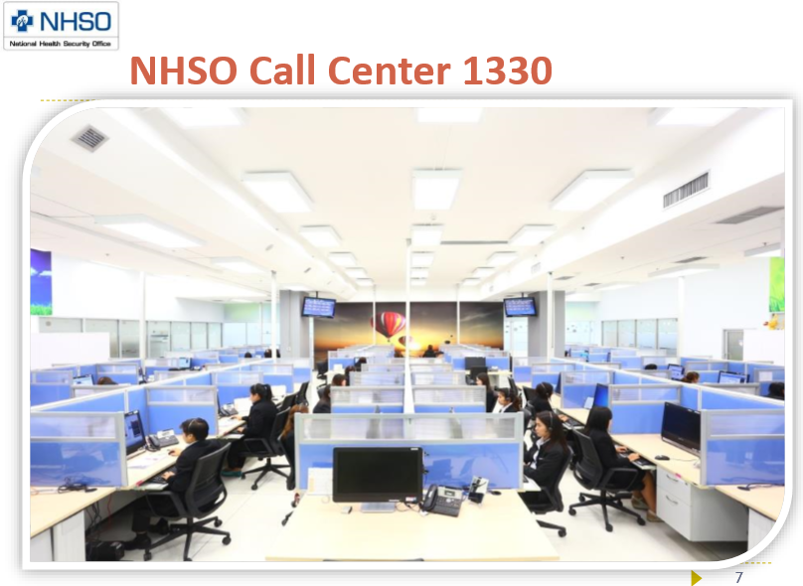
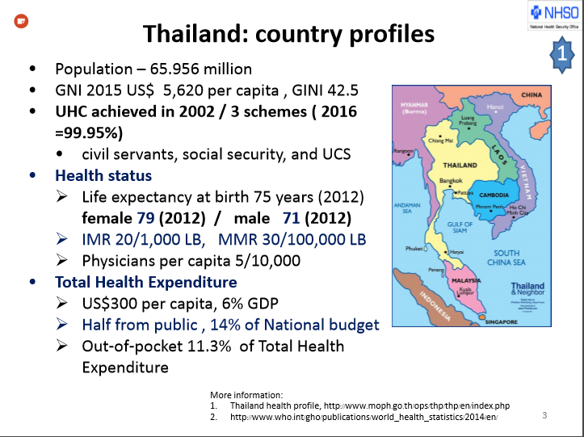
Experience in Thailand

Slide 52
Problems of The Hospital
Post of consultants of eye, anesthesia should be fulfilled immediately.
The repairing and maintenance of hospital building authority should be shifted from HED to PWD.
Oxygen plant should be repaired immediately and a manpower should be engaged.
Separation of words where the number of consultants is more than one.
Condemnation of unwanted items should be done immediately.
The campus should be cleaned.
Medical technologist lab should be appointed immediately in blood bank.

Slide 53
Activities Done
Health education in three places with community response.
Established NCD corner .
Arrangement of effective pediatric outdoor.
Digital disease profiling system in every word.
24 hours EOC service.
Effective post-natal care.
The construction work of 250 bedded has started.

Slide 54
Activities Done
Improved infection control system.
Emergency use of ECG, pulse-oxymeter, glucometer.
Everyday ultrasonography service.
Arrangement of effective training of MA by creating adaptable environment.
Established representative control system.
Established gate-pass system to control visitor.
Removal of unnecessary bill boards and improved beautification.

Slide 55
Comparative Data of Delivery of best performing EOC center of Khulna Division in 2017
SL No | Name of institute | ANC | NVD | C. Section | Total
01. | Jhenaidah Sadar Hospital | 15360 | 1839 | 1143 | 2997
02. | 250 bed Hospital, Jessore | 13152 | 1327 | 1778 | 2967
03. | Chowgacha UHC | 18650 | 2163 | 759 | 2922
04. | Khulna Medical College Hospital | 6977 | 1455 | 1228 | 2683
05. | 250 Bedded Hospital, Kushtia | 4735 | 1595 | 919 | 2514
06. | Ad-din Hospital Jessore.

